Slide 1
Endocrine System
Endocrine organ are ductless glands that secrete their products or hormones directly into the intercellular tissue or perivascular connective tissue spaces from which they reach the blood of circulating system. As a result, dense blood & lymph supply present in these organs. Functions of the animal organism are affected by these endocrine organs in connection with the nervous system.
Thyroid gland
Parathyroid gland
Adrenal gland
Pituitary gland

Slide 2
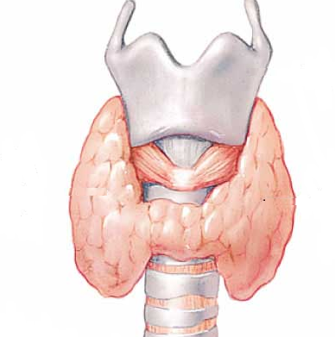
Thyroid gland
Thyroid cartilage
(larynx)
Thyroid gland
Trachea

Slide 3
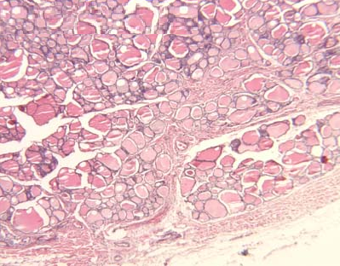
Thyroid gland
Colloid
Thyroid follicles
Connective tissue trabeculae
from the capsule
Blood vessels

Slide 4
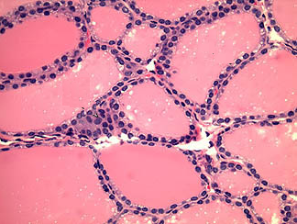
Thyroid gland
Colloid
Follicular cell
Parafollicular cell

Slide 5
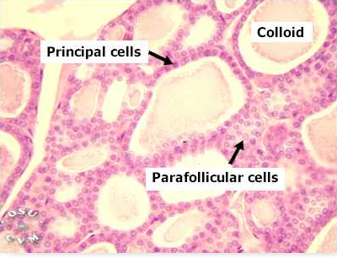
Thyroid gland

Slide 6
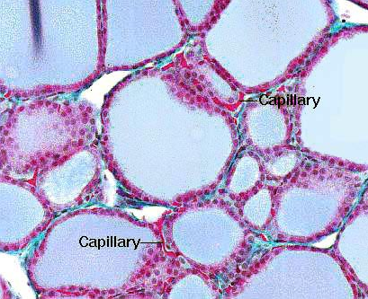
Thyroid gland

Slide 7
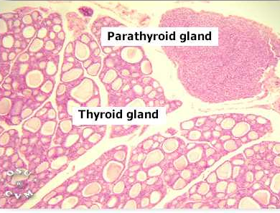

Slide 8
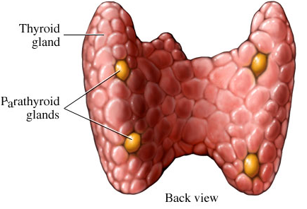
Parathyroid gland

Slide 9
Thyroid gland
Capsule & trabeculae: The gland is surrounded by a thin capsule of dense irregular connective tissue. Thin trabeculae extend from the capsule into the parenchyma. From trabeculae, extend a sparse of loose interstitial connective tissue & reticular fibers surround the basement membrane of the thyroid follicles.
Follicles: The gland consists of numerous follicles of 20 to 500 µm in diameter, usually filled with colloid & lined by follicular cells. In rest state, epithelium is low cuboidal or squamous & the colloid appears very dense. In stimulated state (by TSH), the epithelium become cuboidal or columnar (their nuclei are ovoid or spherical, located near the base of cells) & the colloid is dissolved. The epithelium is surrounded by basement membrane, a sparse connective tissue & dense network of capillaries & lymph vessels. Follicular colloid stains red with Azocarmine & blue with aniline blue. Colloid is PAS-positive due to its content of glycoprotein (thyroglobulin). Other cell can be found is parafollicular or C cells which are characterized by their peripheral position within the follicular epithelium & their lightly stained cytoplasm. These cells are considered the source of calcitonin (to decrease blood calcium against parathyroid hormone).

Slide 10
Parathyroid gland

Slide 11
C.T. capsule

Slide 12
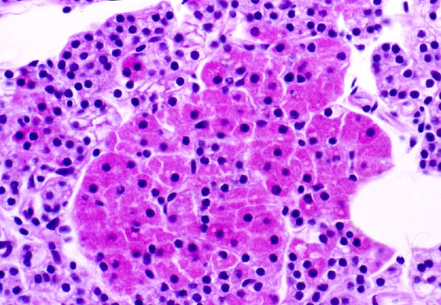
Parathyroid gland
Dark Chief cells
Oxyphilic cells
Light Chief cells
Dark Chief cells

Slide 13
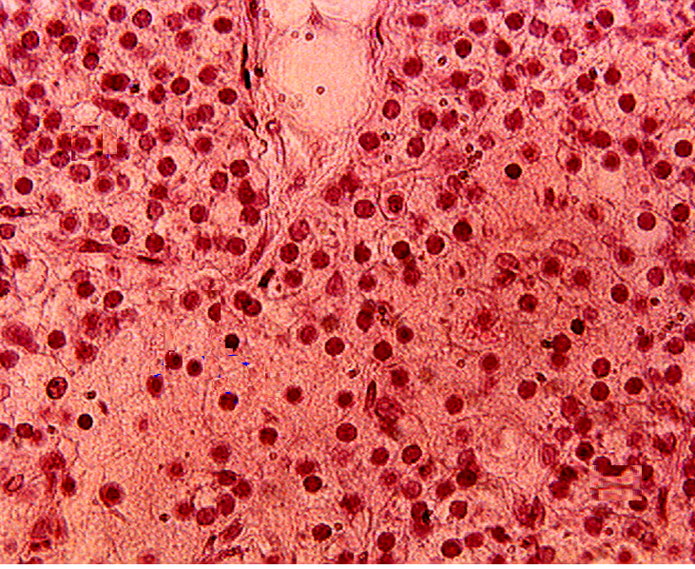
Parathyroid gland
Reticular C.T.
Dark Chief cells
Light Chief cells
Oxyphilic cells
Blood vessel

Slide 14
Parathyroid gland
Capsule & trabeculae: The gland is surrounded by a capsule of dense irregular connective tissue. It is thick in large ruminants & swine. Trabeculae & interstitial connective tissue are abundant in large ruminants & swine, while they are sparse in other domestic animals.
Parenchyma: It is formed of 4 types of cells arranged in clusters, strands or cords.
1. Light chief cells.
2. Dark chief cells.
3. Oxyphilic cells.
4. Syncytial cells.

Slide 15
Light chief (principal) cells:
1. Have large amount of light, acidophilic cytoplasm with glycogen
granules & lipid droplets.
2. The nucleus is large & is stained lightly.
3. The cell is inactive as it has gone through a period of activity &
released its secretory products.
Dark chief (principal) cells:
It appear darker than the light chief cell, because its small
nucleus has condensed chromatin substance surrounded by scant amount of dense cytoplasm which contain a few glycogen granules & lipid droplets.
2. It has more abundant Golgi apparatus, granular ER,
mitochondria & secretory granules than those of light chief cell.
3. Dark & light chief cells are distributed randomly in the
parenchyma.

Slide 16
Oxyphilic cells:
They are few in number, present regularly in horse & large ruminants as a cluster but absent in other domestic animals. It is large up to 27µm in horse possess lightly stained cytoplasm & small nucleus often appears pyknotic.
Syncytial cells:
These are present always in a cluster with indistinguishable limits. They have thin & very acidophilic cytoplasm which surrounds dark & often pyknotic nucleus.

Slide 17
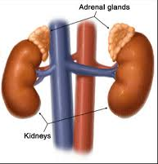
Anterior pole of kidney
Caudal vena cava
Abdominal aorta

Slide 18
Adrenal gland
Capsule & trabeculae: The gland is surrounded by thin capsule which consists of dense irregular connective tissue, occasionally with smooth muscle fibers. Thin trabeculae extend from the capsule & enter the cortex & rarely the medulla.
Cortex: It is subdivided into 3 distinct zones:
1. Zona glomerulosa (outer zone).
2. Zona fasciculata (middle zone).
3. Zona reticularis (inner zone).

Slide 19
Zona glomerulosa: It is formed of irregular clusters & cords of cells in ruminants, whereas, it is arranged in arcs in equine, carnivores & pigs. Glomerulosa cells are tall columnar in equine & are smaller in other domestic animals. Their nuclei are small & dark. Cytoplasm is uniformly stained with little granular ER. Have abundant smooth ER & tubular mitochondria which are characteristic for steroid hormone producing cells.
Zona fasciculata: It is formed of radially arranged cords of cuboidal or columnar cells, usually one cell layer thick. Foamy appearance of its cells is due to the numerous vacuoles in the cytoplasm (originally these were lipid droplets dissolved during routine tissue processing). The nuclei are larger than those of glomerulosa. Cytoplasm contains large Golgi complex, mitochondria and more abundant rough ER & smooth ER than in the glomerulosa.

Slide 20
Zona reticularis: It is an irregular network of anastomosing cell cords. The cells are polyhedral & have roughly same features of fasciculata. Cytoplasm has little lipid droplets & their nuclei are hyperchromatic & often pyknotic.
Both fasciculata & reticularis have many sinusoidal capillaries which are continuous into the medulla.
Medulla: When fixed with chromium salts it showed 2 types of chromaffin cells invested in dense network of sinusoidal capillaries. Scattered among the chromaffin cells, single or clusters of sympathetic ganglion cells.

Slide 21
Chromaffin cells:
Norepinephrine-producing cells:
These are an outer medullary columnar chromaffin-positive cells contain large spherical nucleus & argentaffin granules. EM examination revealed that the cytoplasm has membrane-bounded granules, numerous mitochondria, abundant RER & Golgi apparatus.
2. Epinephrine-producing cells: These are deeper (central)
medullary, small round or polygonal chromaffin positive cells

Slide 22
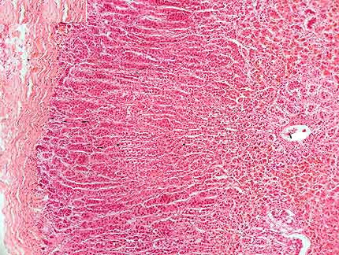
Adrenal gland
1.Capsule
2.Cortex:
Zona glomerulosa
Zona fasciculata
Zona reticularis
3.Medulla
Central vein

Slide 23
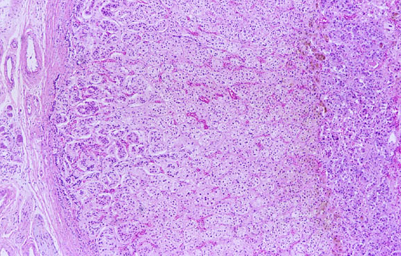
Adrenal gland
1.Capsule
2.Cortex:
Zona glomerulosa
Zona fasciculata
Zona reticularis
Sinusoids
3.Medulla

Slide 24
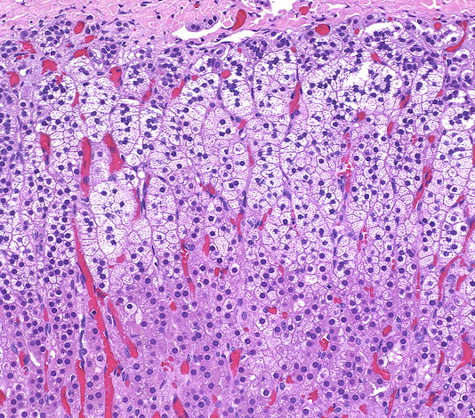
Adrenal gland
Capsule
Zona glomerulosa
Sinusoids
Zona fasciculata

Slide 25
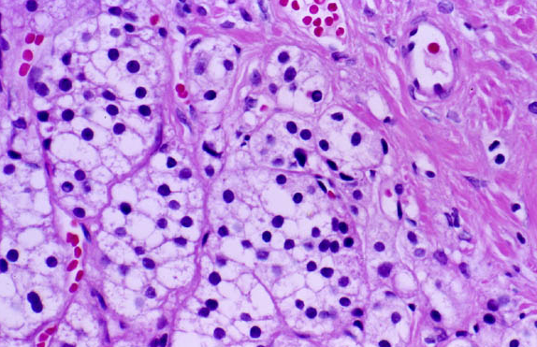
Adrenal gland
Capsule
Zona glomerulosa
Sinusoids

Slide 26
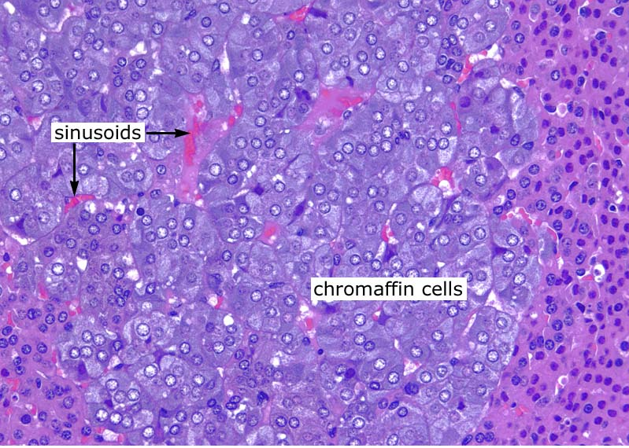

Slide 27
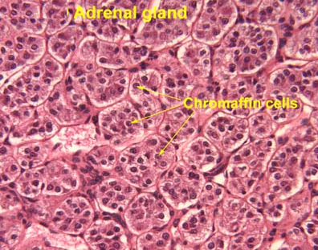

Slide 28
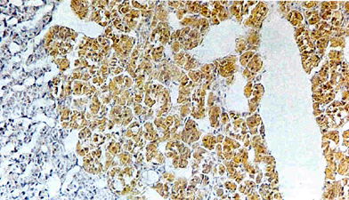

Slide 29
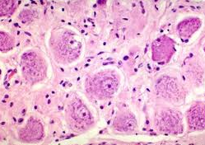
Medulla in adrenal gland
less distinct satellite cells
Nissl granules
Cluster of sympathetic ganglion cells
eccentric nuclei
Nucleolus

Slide 30
Pituitary gland (Hypophysis)
It consists of two portions that are the glandular or adenohypophysis portion & the nervous or neurohypophysis portion.
The gland is connected structurally & functionally with the hypothalamus forming hypothalamo-adenohypophyseal system & hypothalamo-neurohypophyseal system.
It is located in a fossa called sella turcica present in the sphenoid bone of the skull.

Slide 31
Adenohypophyseal portion
Grossly, its cross section appeared pinkish in color, and it is formed from the pars distalis, pars tuberalis & pars intermedia.
Pars distalis:
It consists of clusters & cords of cells in close opposition to a dense network of capillaries (sinusoids).
The cells of pars distalis are classified as in below into:
1. Chromophilic cells:
Acidophil: Aurantiphils & Erythrophils
Basophil: Purple amphophils , Red
amphophils & Cyanophils
2. Chromophobic cells

Slide 32
Acidophil cells
These cells are larger & widely distributed than the chromophobic cells. They are round or ovoid in shape with densely stained granules in their cytoplasm. Usually, they are located adjacent to the blood sinusoids.
These cells have red-orange granules and are produced somatotropic hormone (STH) or growth hormone & prolactin hormone. If the granules stained red with azocarmine, so are called erythrophils and if stained orange with orange-G stain called aurantiphils. Erythrophils granules are produces prolactin hormone so that their number is increased in pregnancy & decreased post parturition period. In rats, erythrophils produce luteotropic hormone (LTH). Aurantiphils are the source of STH, so that their number is decreased in dwarfism & increased in gigantism & acromegaly (enlargement of distal ends of the extremities).

Slide 33
Basophil cells
These are basophilic cells & stain strongly with PAS stain due to their large content of glycoprotein and their granules have some degree of affinity for alcian blue stain too. On the basis of their different staining affinity, there are 3 types of basophilic cells:
Cyanophils (TSH cells): their granules stain well with aldehyde fuchsin & alcian blue. It enlarges in thyroidectomy & decreased in size after administration of thyroxine, so considered TSH cells.
Purple amphophils (FSH cells) & Red amphophils (LH cells): These cells are enlarged significantly after castration.

Slide 34
Chromophobic cells
These are large cells with little cytoplasm and only a few peripheral granules which have weak affinity for either acid or basic dyes. Their number is increased after adrenalectomy so called as corticotrophs (ACTH cells).

Slide 35
Pars intermedia
It is small part of the gland & is located between pars distalis & pars nervosa or neurohypophysis & they are separated from each other by hypophyseal cleft.
Its structure consists of thin layer of palely stained basophilic cells & follicles filled with colloid. Sometimes, stands of basophilic cells are extended into the pars nervosa. Pars intermedia produce melanocyte stimulating hormone (MSH) under the hypothalamus control.

Slide 36
Pars tuberalis
It consists of epithelial cell clusters surrounding the median eminence. There is a thin layer of connective tissue separates it from the median eminence.
Wide hypophyseal portal veins course through the pars tuberalis in a proximodistal direction.
The cells of pars infundibularis are gonadotrophs such as FSH & LH.

Slide 37
Neurohypophysis
Grossly, its cross section appeared white in color, and it is formed from the pars nervosa, infundibular stalk & median eminence.
It consists of unmyelinated nerve fibers originated from diencephalon, run through the infundibulum to the pars nervosa where their ends are enlarged. Pituicytes are found in between them & blood capillaries. They are small cells with branched processes; their cytoplasm contains fat droplets and stainable granules. These cells are similar to the neuroglia of the CNS & they are more numerous in pars nervosa than in infundibulum and median eminence.

Slide 38
The most characteristic feature is the enlargements of the axons which are contained neurosecretory granules (Herring bodies), mitochondria, dense lamellar bodies, vesicles, filaments & tubules which are considered a place of storage & disposal of hormones.
Function: It produce oxytocin hormone which enhance the fetus delivery by its effect on uterus wall & it induce milk secretion from the mammary glands. Also it produces antidiuretic hormone (ADH) so increase blood pressure.

Slide 39
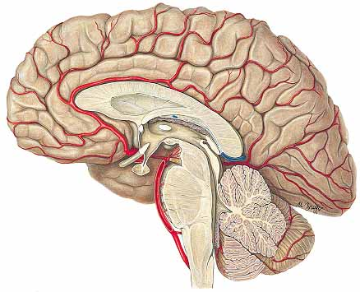
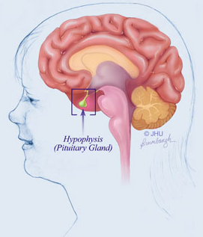
Hypophysis (Pituitary Gland)

Slide 40
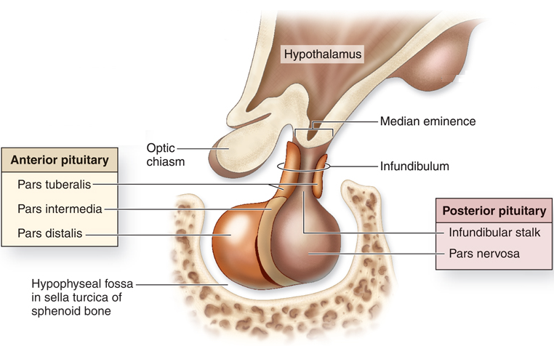
Hypophysis (Pituitary Gland)
Hypophyseal stalk

Slide 41
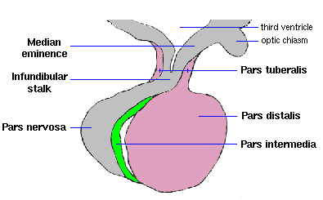
Hypophysis (Pituitary Gland)

Slide 42
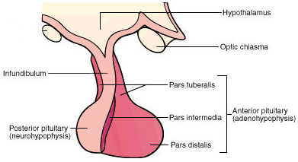
Hypophysis (Pituitary Gland)

Slide 43
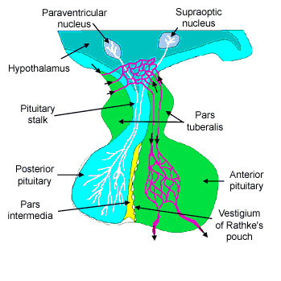
Hypophysis (Pituitary Gland)

Slide 44
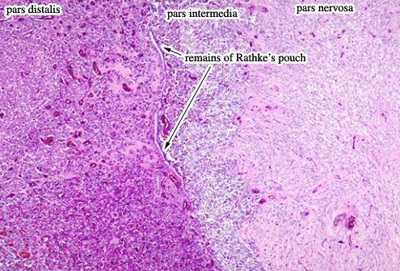
Pars distalis

Slide 45
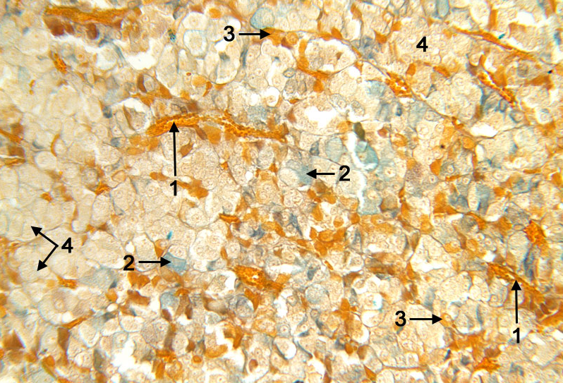
Pars distalis
1. Sinusoids contained erythrocytes 2. Basophil (blue) 3. Acidophil (orange) 4. Chromophobic cells

Slide 46
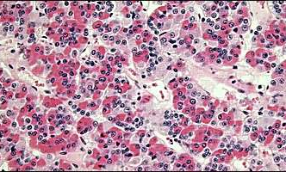
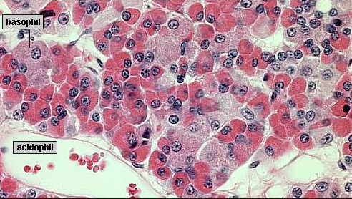
Pars distalis

Slide 47
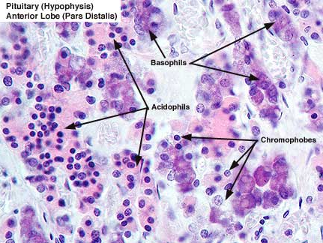
Pars distalis

Slide 48
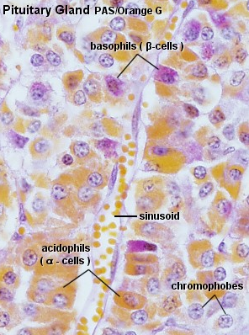
Pars distalis

Slide 49
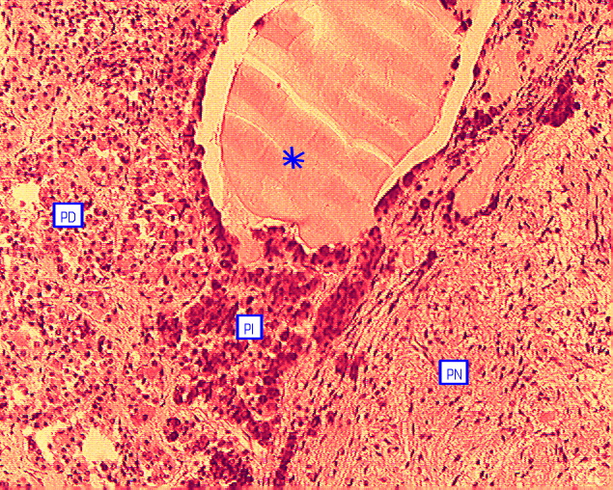
Pars intermedia
Pars distalis
Pars intermedia
Pars nervosa

Slide 50
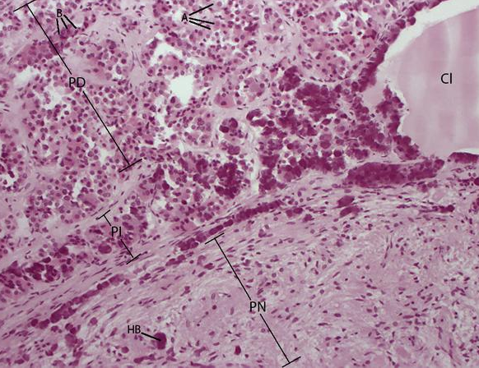
Pars intermedia

Slide 51
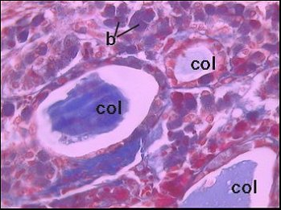
Pars intermedia

Slide 52
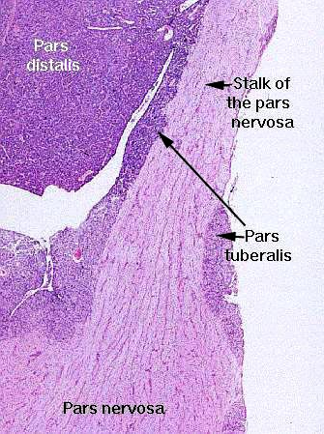
Pars nervosa

Slide 53
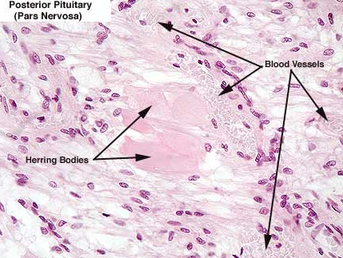
Pars nervosa
Pituicytes

Slide 54
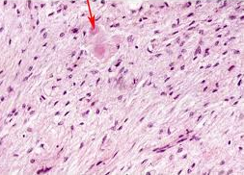
Pars nervosa
Herring bodies
Pituicytes
Blood vessels

Slide 55
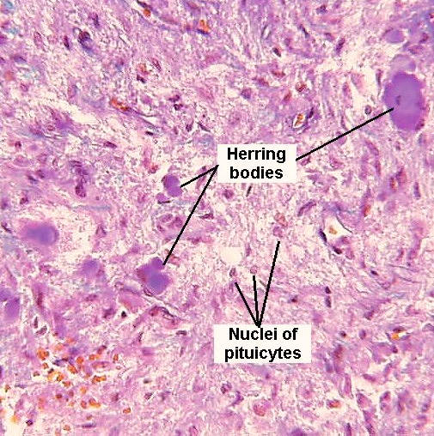
Pars nervosa
Blood vessels

Slide 56
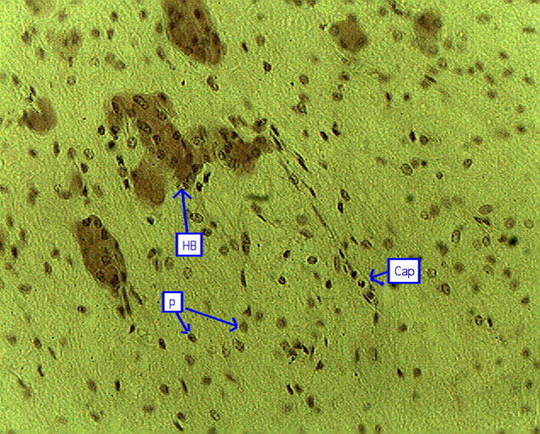
Pars nervosa
Herring bodies
Pituicytes
Blood capillary

Slide 57
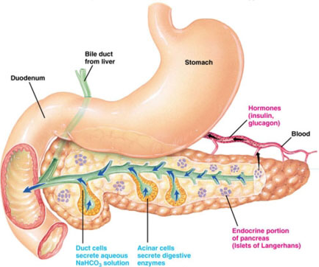

Slide 58
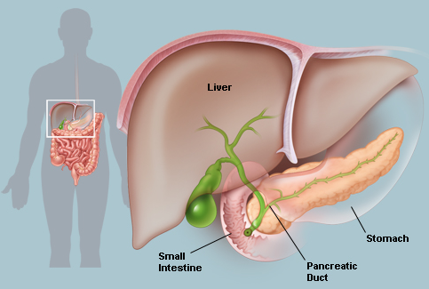

Slide 59
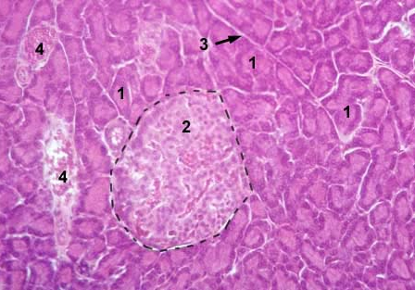
Pancreas
interlobular connective tissue septa
Blood vessel
acini
Blood vessel
Islet of langerhans

Slide 60
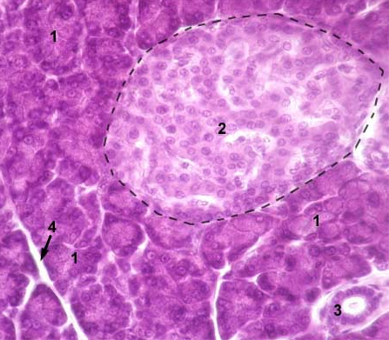
Pancreas
acini
Islet of langerhans
interlobular connective tissue septa
Intralobular duct

Slide 61
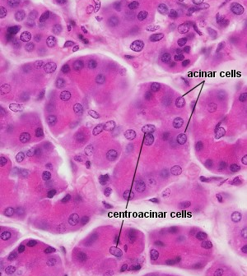
Pancreas

Slide 62
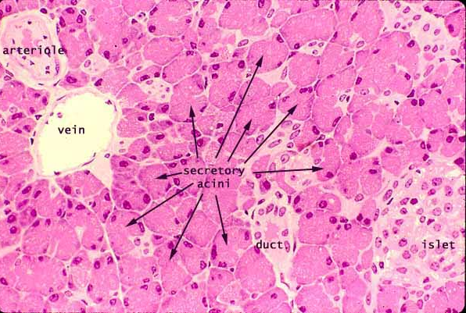
Pancreas

Slide 63
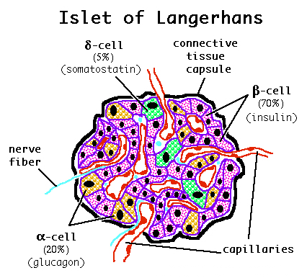

Slide 64
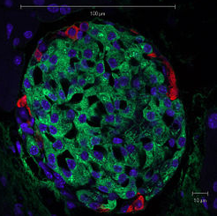
Fluorescence Technique
Beta cell - Green -Insulin 70%
Alpha cell - Red- glucagon 20%
Blue: nuclei

Slide 65
Islets of Langerhans:
The pancreas is a gland organ in the digestive and endocrine system of vertebrates. Islet of langerhans is the endocrine gland which produces several important hormones, including insulin, glucagon, and somatostatin.
Islets of Langerhans are lightly staining, large, spherical clusters of cells which are different from darker-staining cells of the surrounding acini of the exocrine part by not containing the large zymogen granules.

Slide 66
Many capillaries are interspersed between the cells of Islets of Langerhans. The capillaries are lined by layers of endocrine cells in direct contact with vessels, either by cytoplasmic processes or by direct apposition.

Slide 67
Islets of langerhans contain three different types of cells:
1. Cells that secrete glucagon (alpha cells, 20% 0f cells).
2. Cells that secrete insulin (beta cells, 70% of cells).
3. Cells that secrete somatostatin (delta cells, 5% of cells).
4. Also, C-cells (no known function, 5% of cells) are found in some
species.
Function: The islet of Langerhans plays an imperative (principal)
role in glucose metabolism and regulation of blood
glucose concentration.

